Slide 1
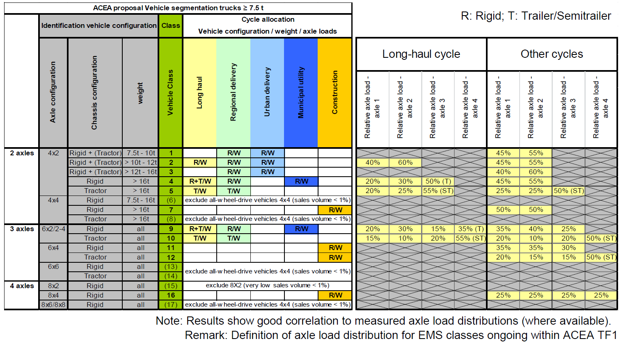
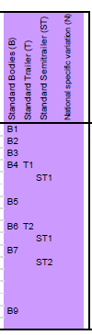

Slide 2

2 Axle
4x2r
1, 2, 3
4x2rt
4x2r
4
4x2tt
6x2r
5
3 Axle
6x2rt
8x4
9
9
10
6x2tt
Undef

Slide 4
VAN

Slide 5
City Bus

Slide 6
Coach

